Slide 1
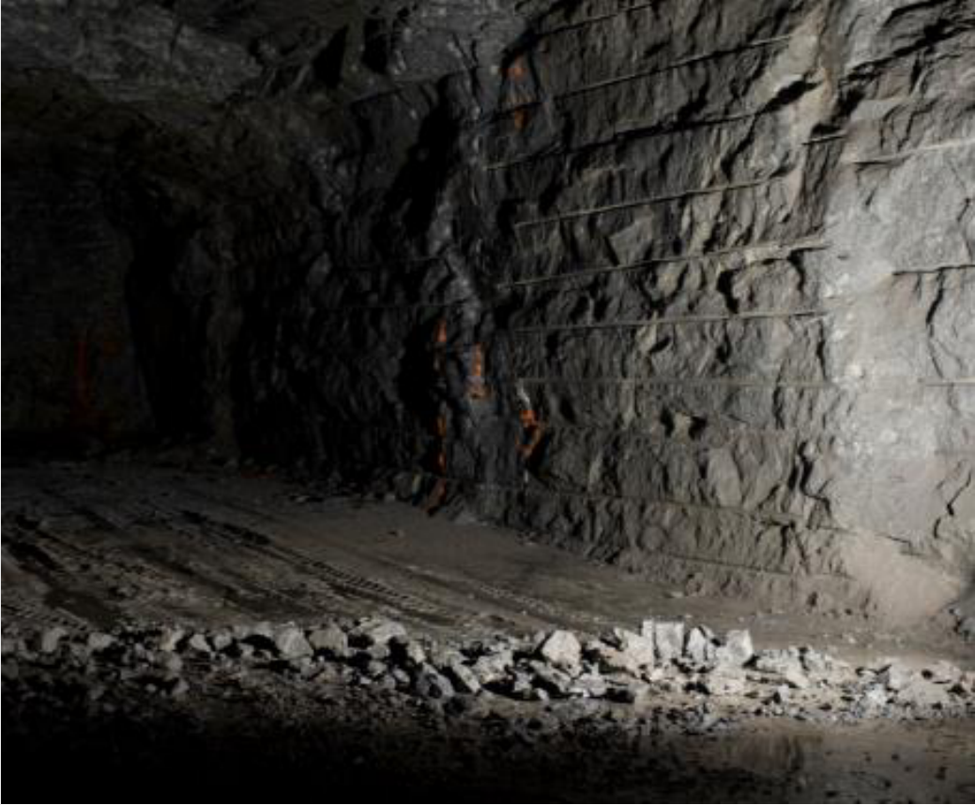
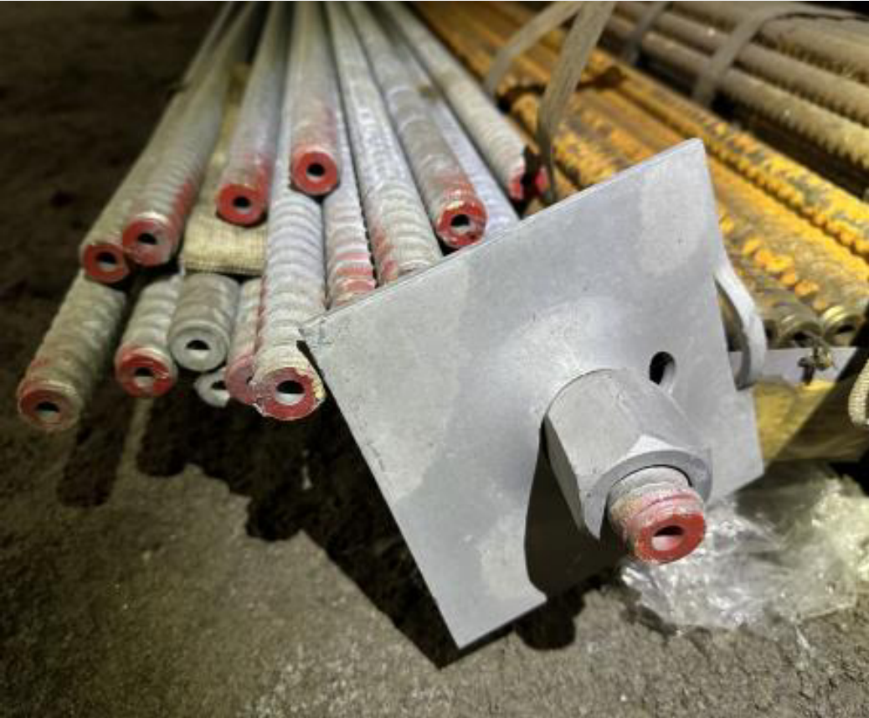
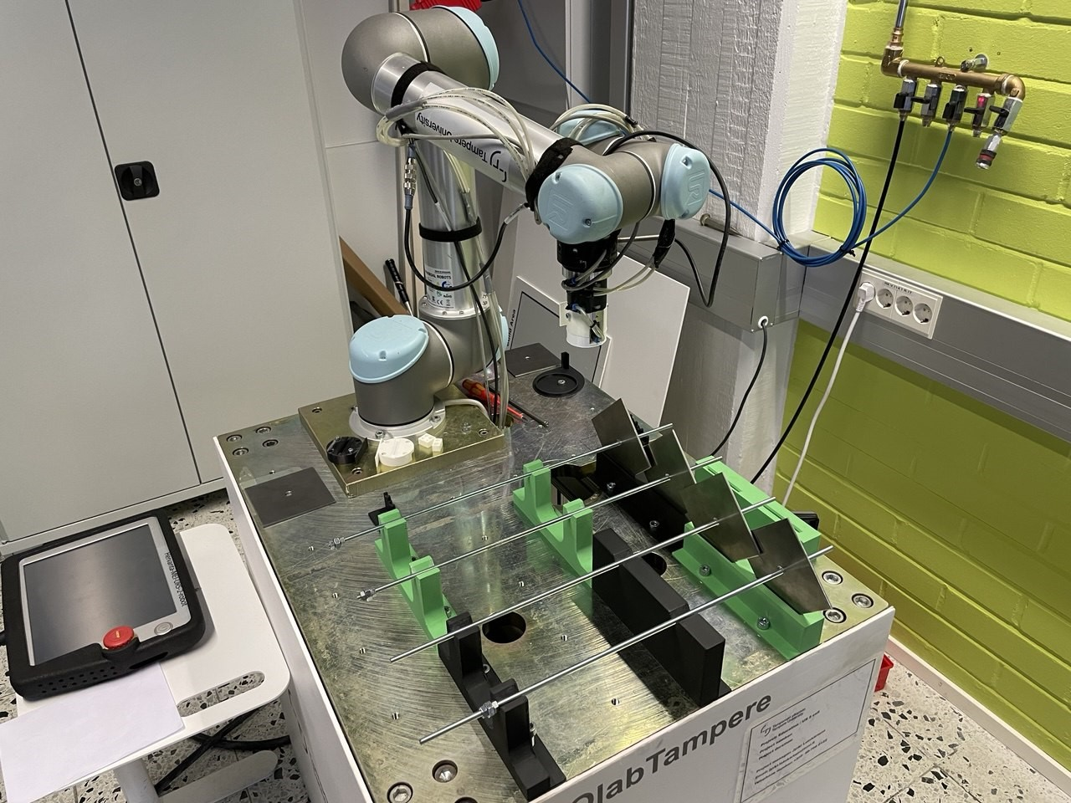
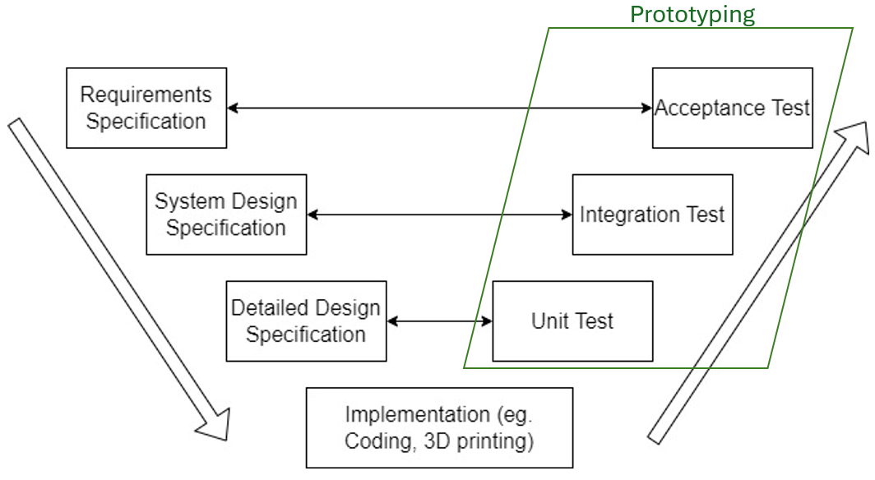

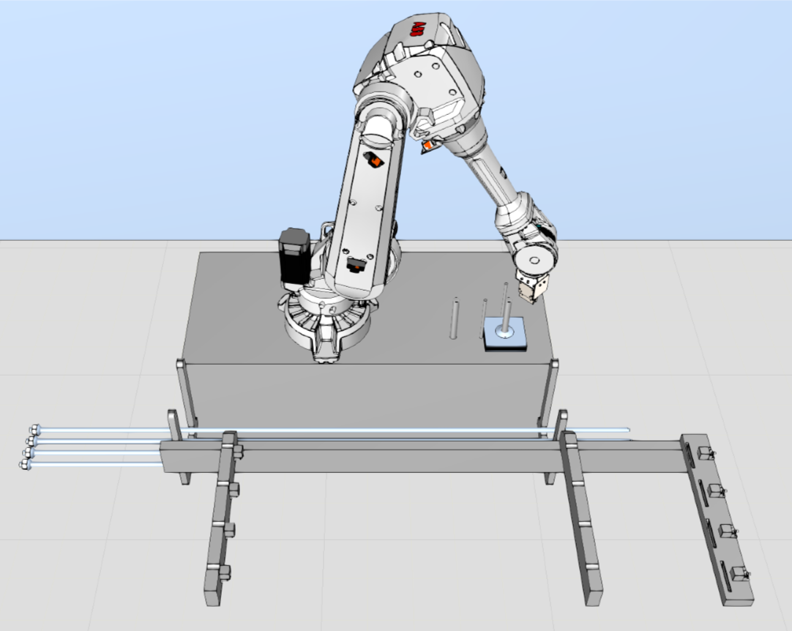
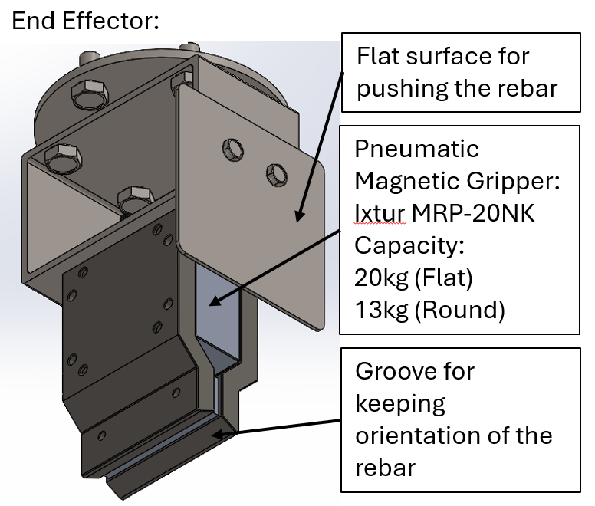
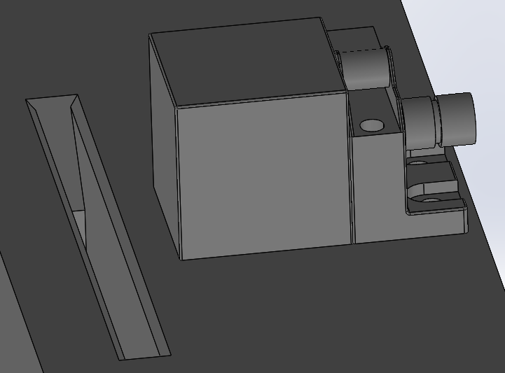
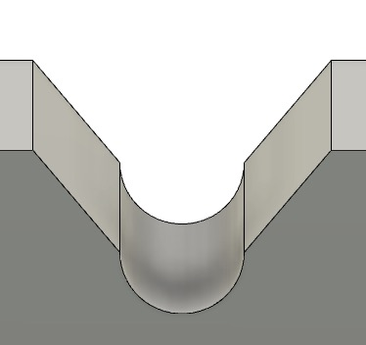

Industrial Robots in Harsh Conditions
ROBO.666 Robotics Project Work 2024
Daniel Pedraglio O'Hara, Eren Pekgöz, Kin Tung
Introduction:
In mining excavations, walls and roofs are reinforced to prevent cave-ins. This is done by inserting rock bolts into them. As part of an automated mining operation, a machine will need to assemble rock bolts for use. We propose a method for rock bolt assembly using a robot manipulator.
Work Environment:
Outdoor and indoor (5x5m tunnel)
Temperature: -40 to 40°C
Darkness and bright daylight
Dust, mud, moisture, snow, rain
Prototype:
Goals:
Design a rock bolt assembling robot using only one robot manipulator
Design robot cover for harsh conditions
Demonstrate rock bolt assembling with a scaled-down prototype
Pictures of a mining tunnel and rock bolts provided by Sandvik
Assumption:
Rebars are delivered to the stack in an organised bundle with a jig.
Development:
In this project, V model development cycle was followed. Design was validated and verified by the prototype.
Robot | Universal Robots UR5
End effector | Pneumatic magnetic gripper + casing
⌀25mm Rebar | ⌀6mm screw rod (diameter 1:4, length 1:6)
200x200mm Plate | 100x100mm steel plate (1:2)
Tray & others | 3D-printed modules screwed onto the table
The prototype was scaled down to between 1/2 and 1/6 of full scale, while the plate opening-to-rebar diameter ratio remains the same to test the feasibility of inserting rebar into plate opening. All 3D-printed pieces replicate key features of the original design.
Main specification of the system:
Prototype Test Video:
Robot Manipulator:
ABB IRB 4600-45/2.05
Built-in force sensor
Robot Controller:
ABB IRC5
Robot Cover Design Proposal:
Against Dust, mud, moisture, snow and rain:
→ Robot cover cloth, compressed air nozzles on tray
Against low temperature:
→ Heating element or heating blanket
Design role of group member:
Kin Tung
System design
End effector design
Eren Pekgöz
Bolt tray design
Robot cover protection design
Daniel Pedraglio O'Hara
Robot manipulator selection
Programming of prototype
Rebar Stack
Plate Stack
Aligns rebars with the hole on the plates.
Rebars fall into alignment due to angled edges.
Aligns the plates to be assembled with the rebars.
Plates fall into the alignment due to angled edges.
1. Pick and place metal plate
Robot picks a metal plate from plate stack and place it into the slot of bolt tray.
2. Pick and place rebar
Robot picks a rebar from rebar stack and place it onto the rebar guide of the bolt tray.
3. Assemble rock bolt
Robot pushes the rebar into the opening of the metal plate.
4. Finish
Wait for the rock bolts to be picked by another mechanism (out of scope) before starting next cycle.
Repeat above process until all slots are filled.
Repeat step 2 and 3 until all rock bolts are assembled.
Work Cycle:
Design Simulation:

